Slide 1
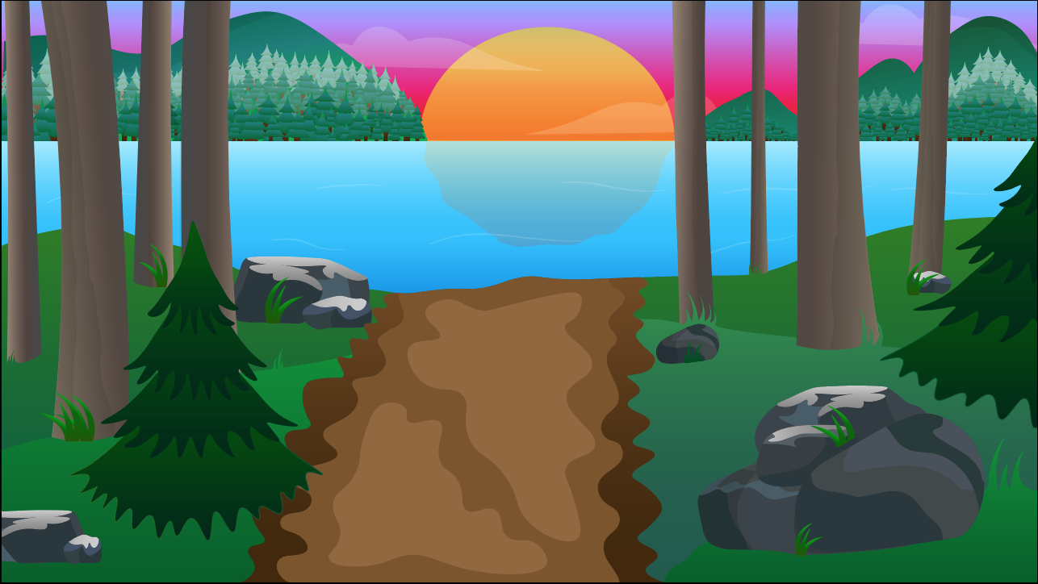
Unity 3D and Illustrator: Game Illustration
Rachel Curtis

Slide 2
Adobe Illustrator : “Moon Phases”

Slide 3
Collaboration
Designing for a client
The necessity to iterate design when creative choices change
Practicing new styles

Slide 4
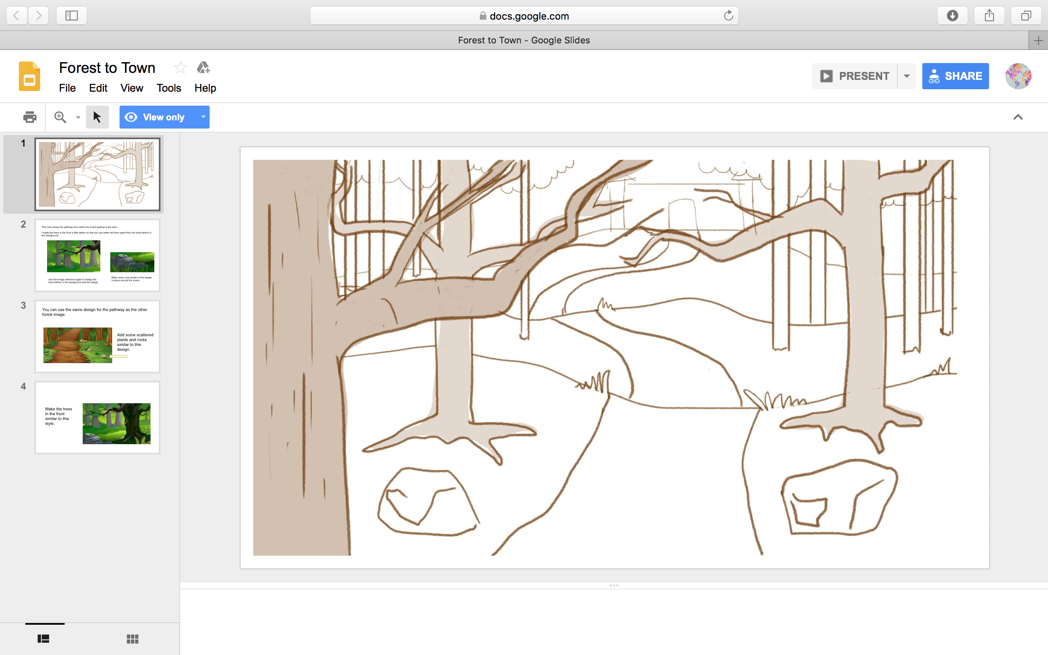

Slide 5
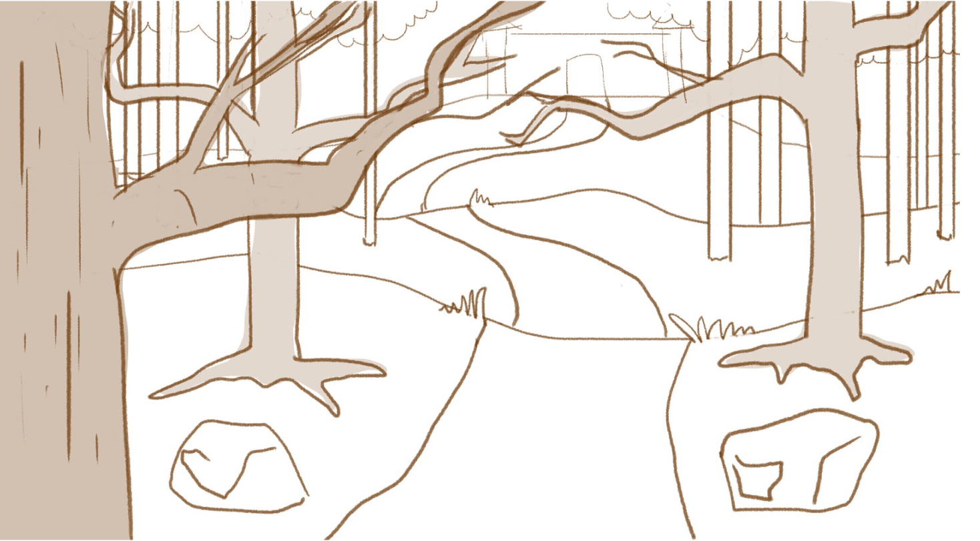

Slide 8
https://youtu.be/Y5-XALAIvmU

Slide 9
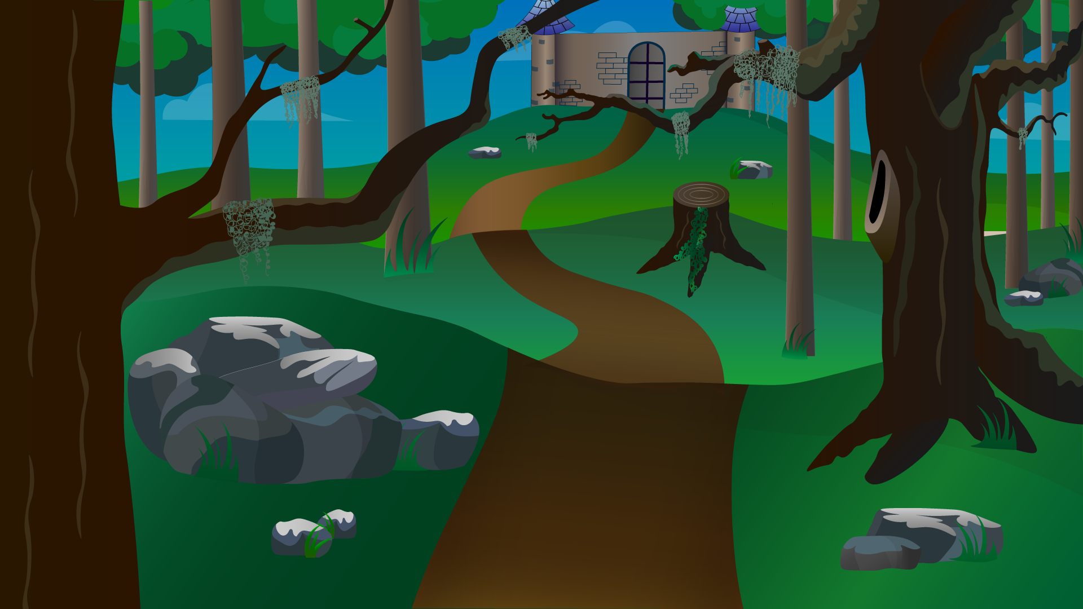

Slide 10
Other Scenes:

Slide 11
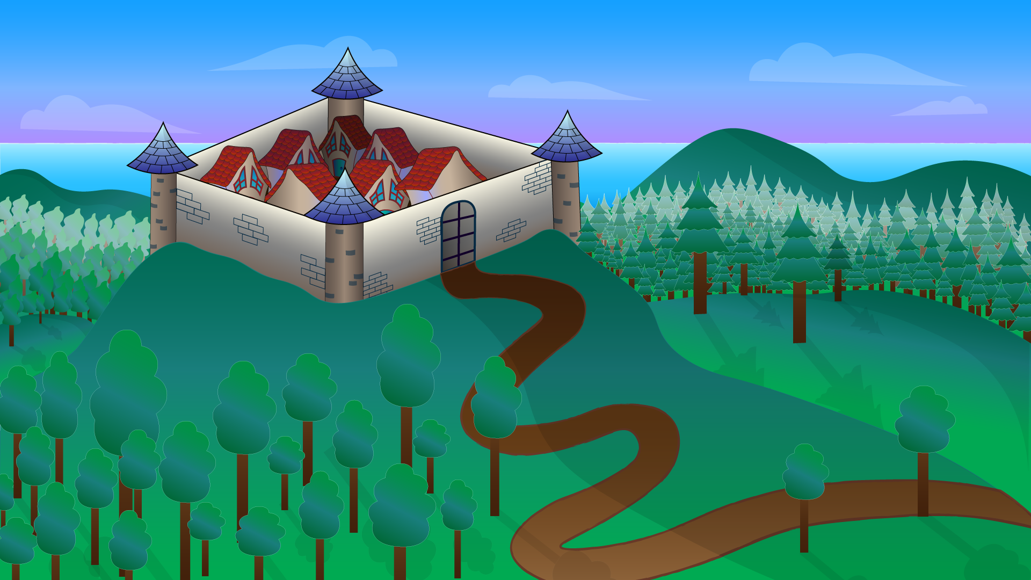

Slide 12
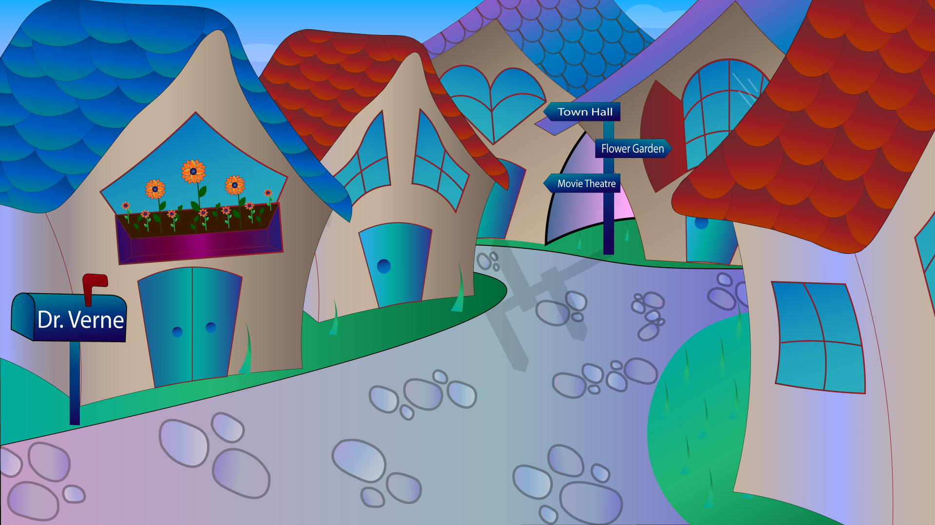

Slide 13
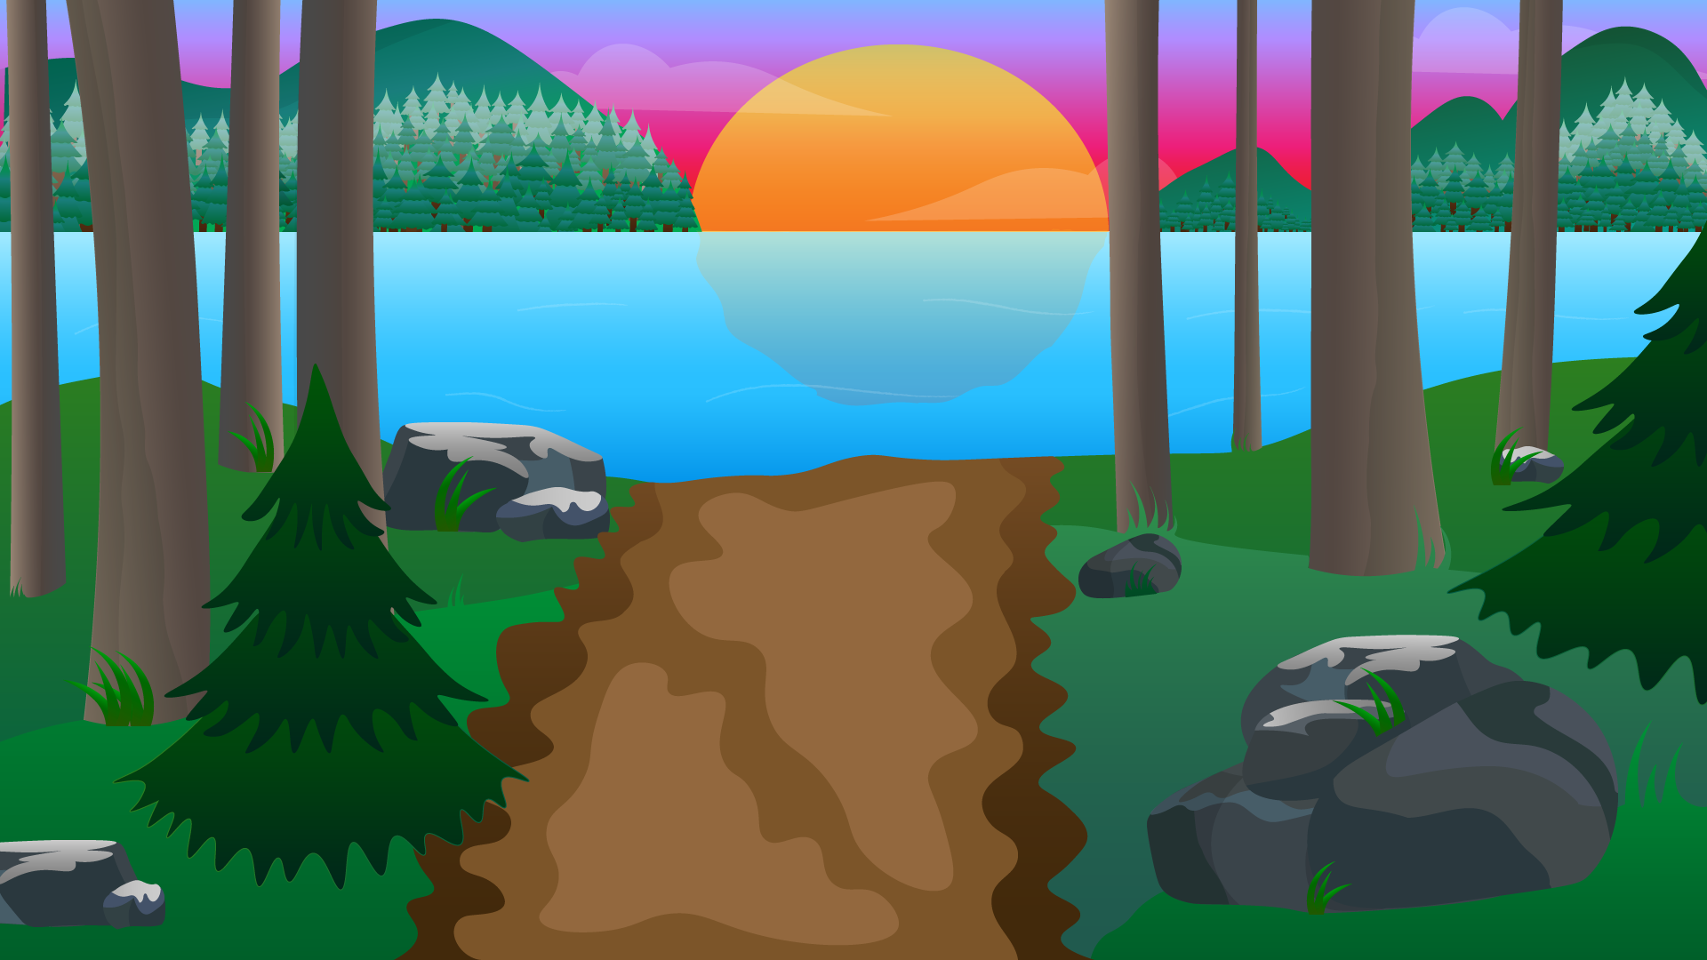

Slide 14
Unity 3D: “Camp”

Slide 15
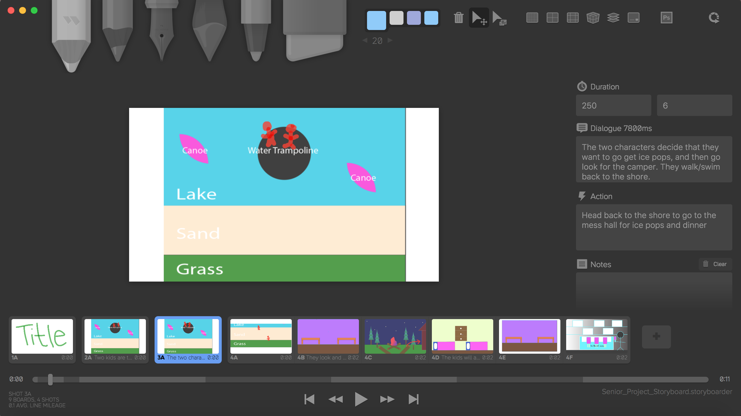

Slide 16
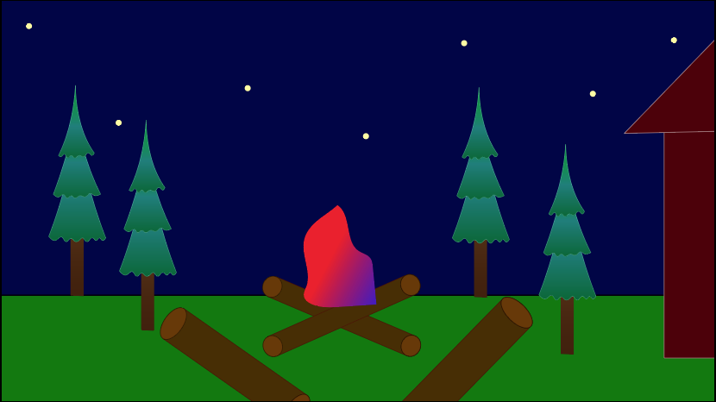
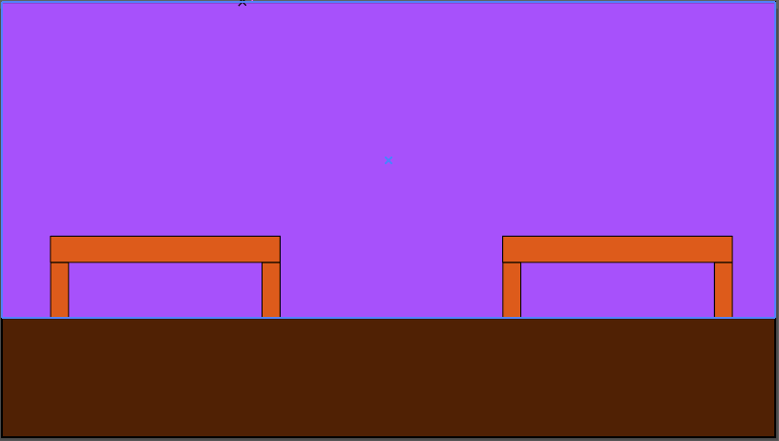
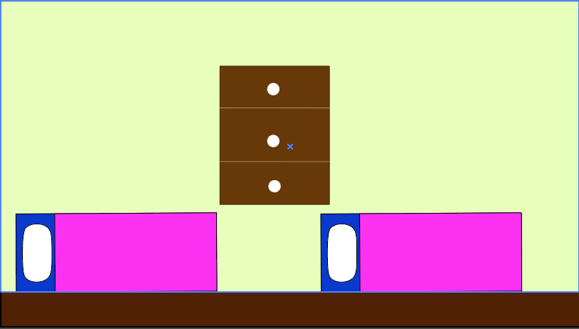
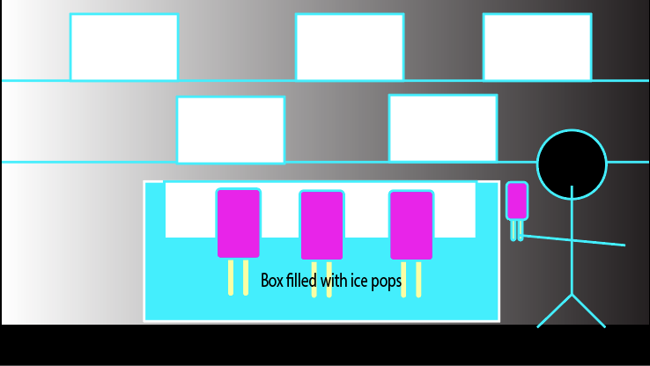

Slide 17
Unity 3D
Used as 3D visualization tool
Learning process
Adapting when something goes wrong
No set method

Slide 19
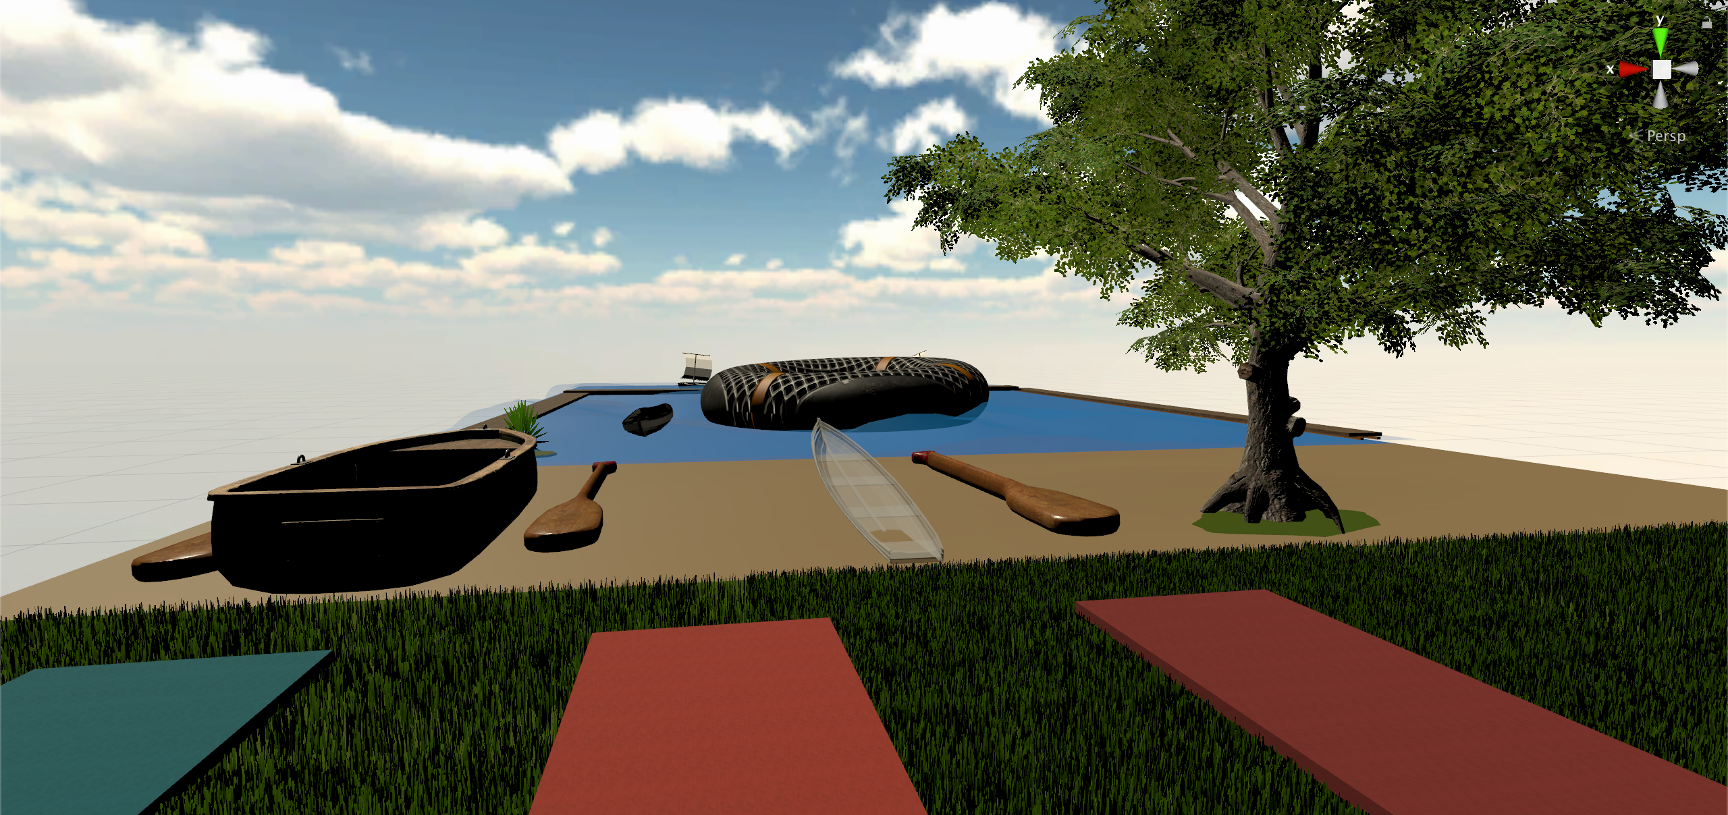

Slide 20
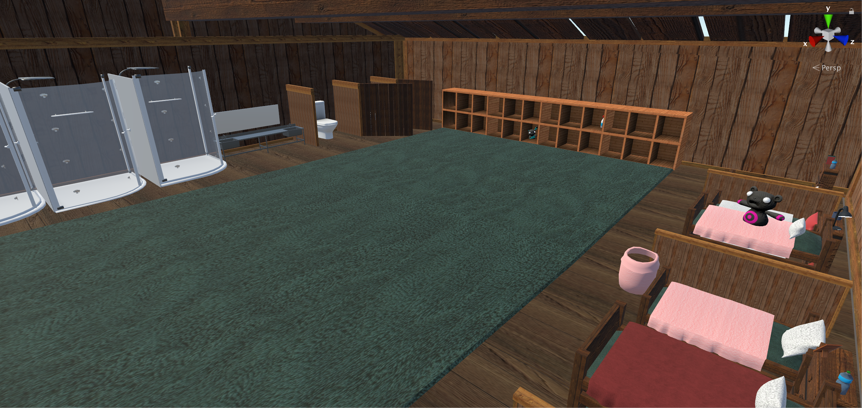

Slide 21
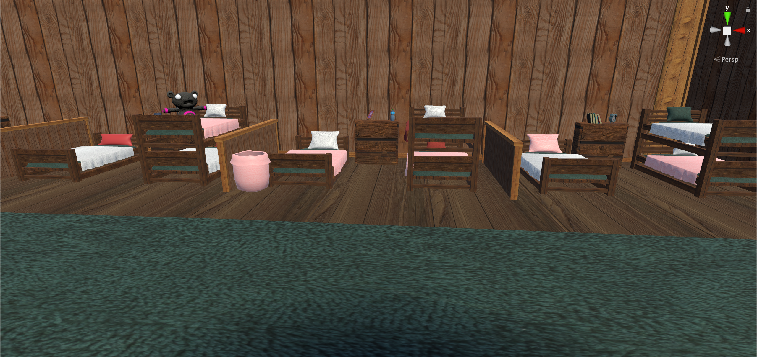

Slide 22
https://youtu.be/Y5-XALAIvmU

