Slide 1
Mara Gedvilas
Senior Showcase, May 2018

Slide 2
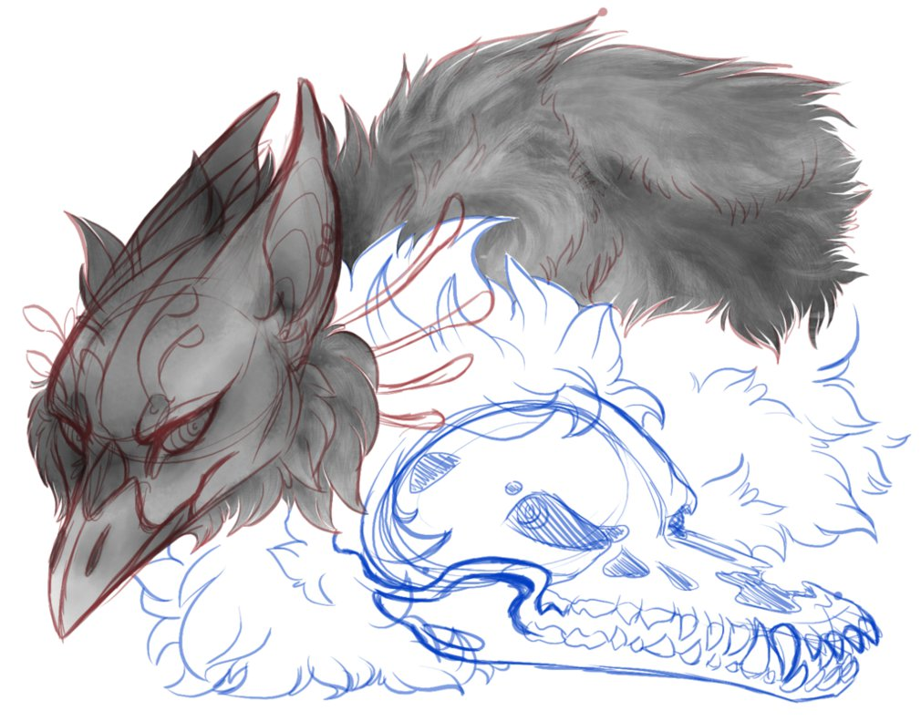
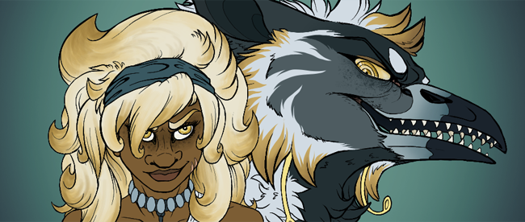
Premise
“Where once deities were thought to have become obsolete, we dare venture into the thick of conflict and opportunity. We find the gods teased with the first taste of sacrifice and loyalty in centuries, the people facing a raw power long forgotten, and turmoil proves inevitable. Time counts down in this struggle for control and power in an era of newly-resurged possibilities.”
The Ember Allies is a project based on a story I’ve been working on for years, following the protagonist Rhea Riccus through a fictional world called Vemori. Find yourself surrounded by mysticism, deities, and fantastical creatures!
My Senior Project set out to capture the major regions of Vemori through a small series of digital landscape paintings.

Slide 3
First Steps
I researched various fascinating geographic structures for inspiration, such as the Tianji Mountain range in China for my region The Verge.
Each piece started out as a rough sketch either in my sketchbook or on the art program itself, which I then brought into Photoshop for the painting process.
The example to the right is the initial sketch for The Verge, including Rhea Riccus’s dual Fiend form (her animal morph). The Verge itself is a critical region in Vemori, as its cryptic tunnel system hosts Nazri’s Shrine.

Slide 4
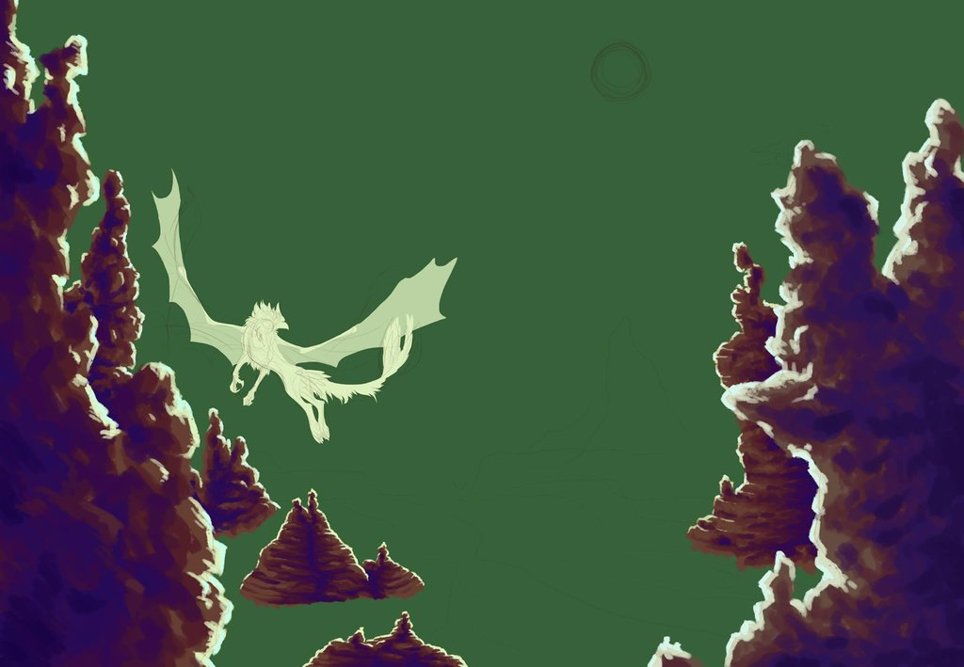
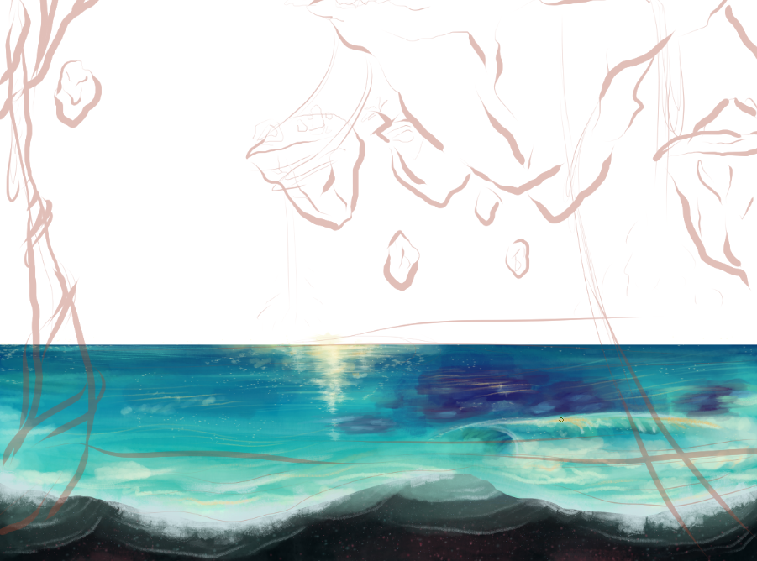
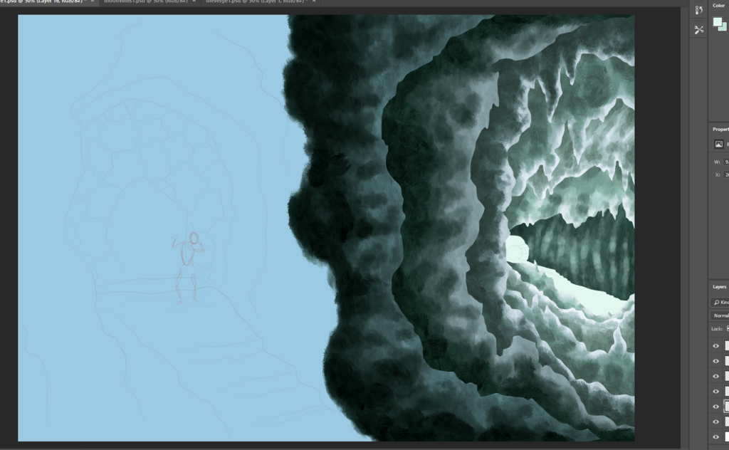
In Progress

Slide 5
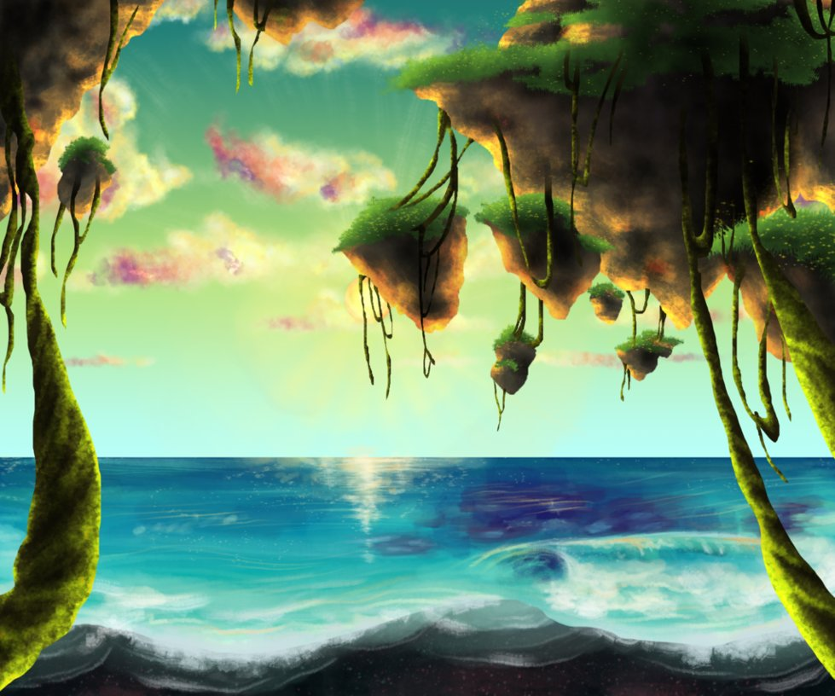
Final Pieces

Slide 6
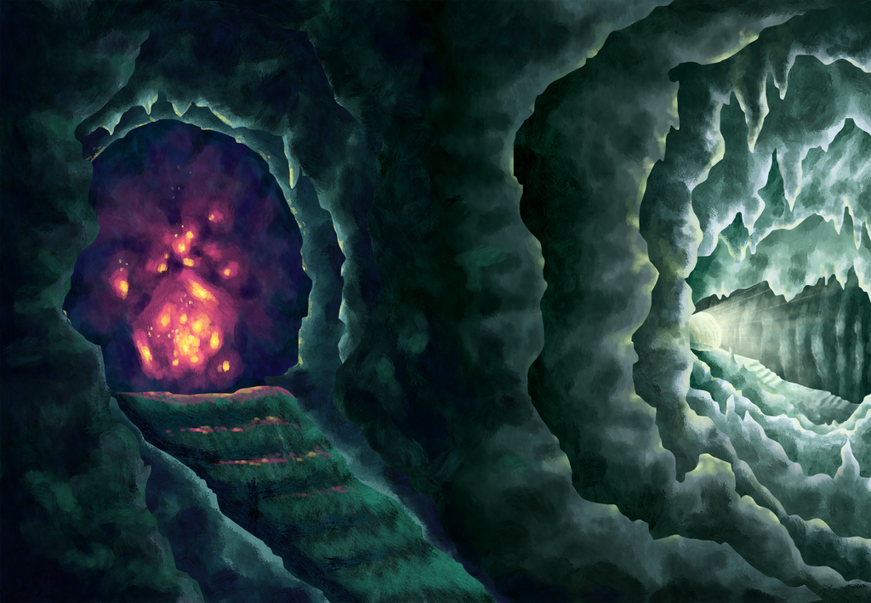
Final Pieces, cont.

Slide 7
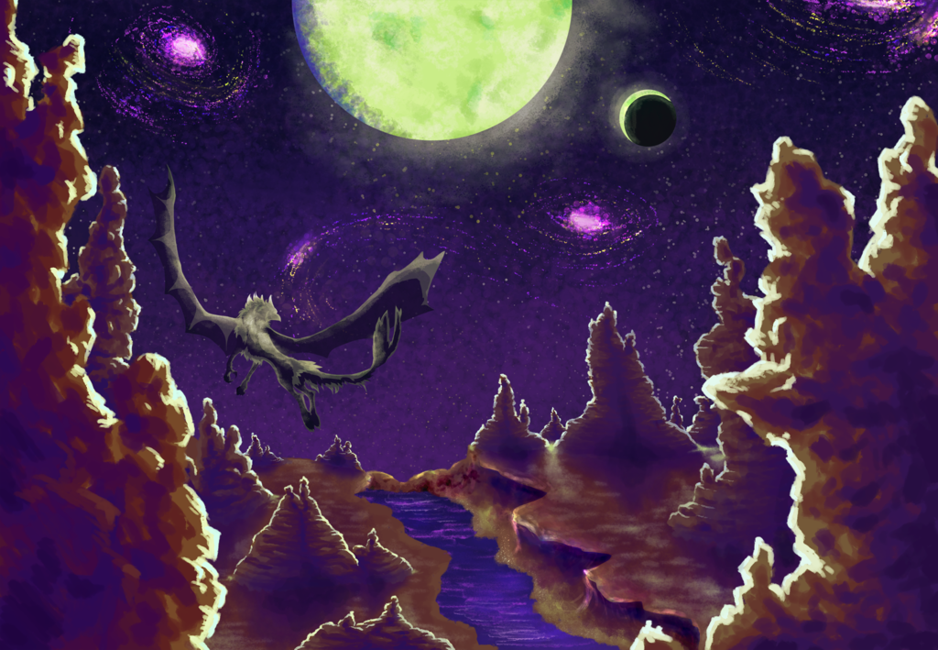
Final Pieces, cont.

Slide 8
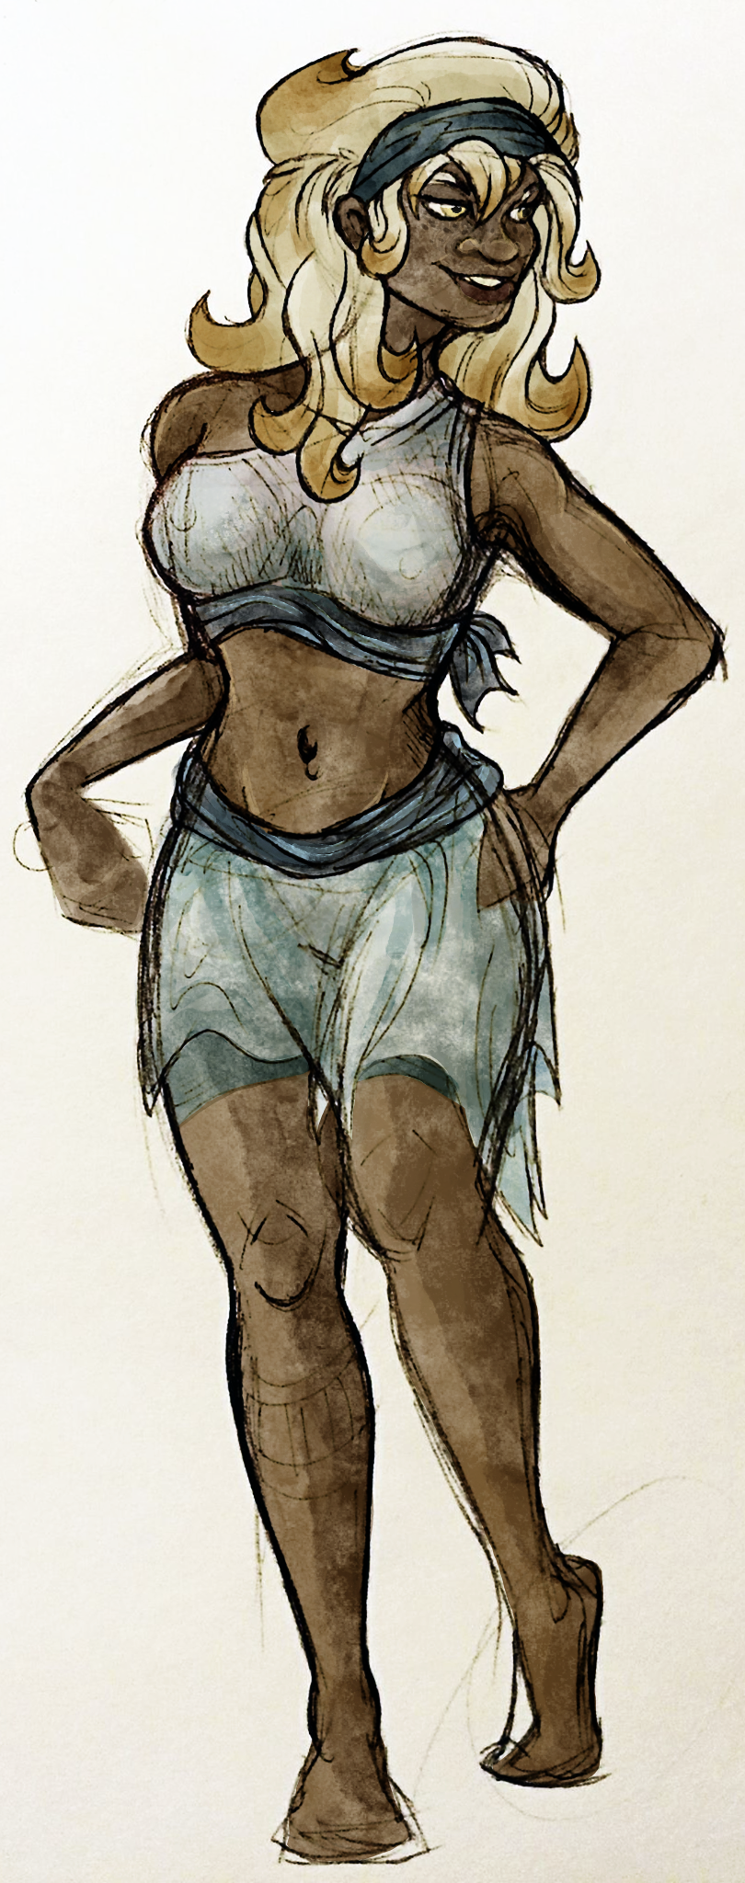
Reflections
I enjoyed the challenge of tackling both digital painting and scenery design for the first time.
In the future, I would spend more time practicing rough paintings and simpler concept work to better prepare for larger, more complex pieces.
More research is necessary, both in real-world scenery as well as in fantasy concept work, to get a clearer idea of the world I envision.
I fully intend to continue The Ember Allies in both the literary and visual fields, and aspire to either have it as a graphic novel or pitch it to an animation studio.

