Slide 1
Plant Based Strength

Slide 2
Background
Started web design career freshman year
Initially graphic designer
Now developer & designer

Slide 3
Why Develop a Site?
Learn E-commerce Business
Email Marketing
Shipping and Selling side of Wordpress Business

Slide 4
Why Plant Based Strength?
Located a need for a product
Compassion for animals
Designing something important

Slide 5
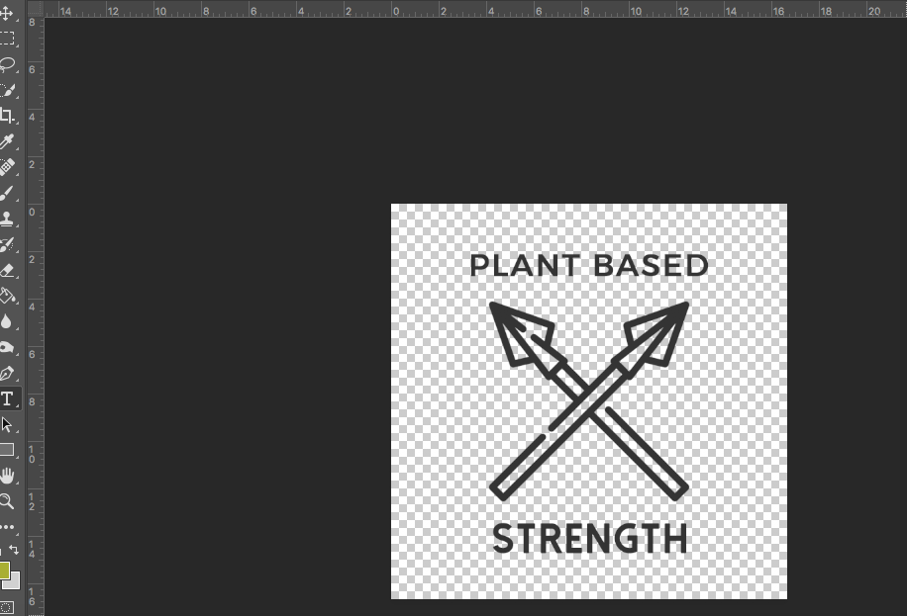
Design Aspect

Slide 7
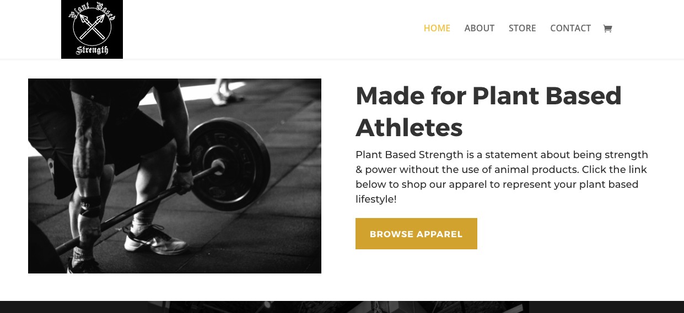
Minimalist Design

Slide 8
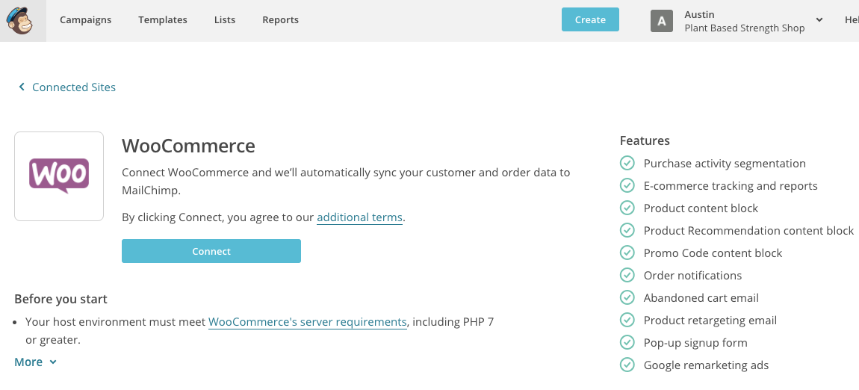
Mail Chimp Integration
All purchases
All subscription pop ups
All subscription Opt Ins

Slide 9
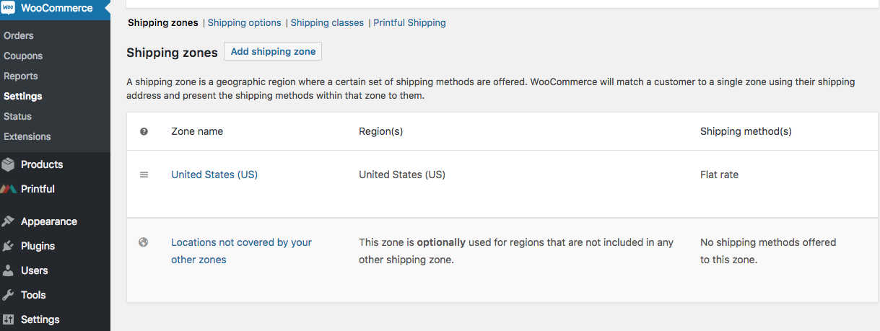
E-Commerce
Shipping Classes, Shipping Zones, Flat Rate Shipping Setup
Variable Pricing for Shirt Sizes and Colors if needed
Discount codes and Order Notifications

Slide 10
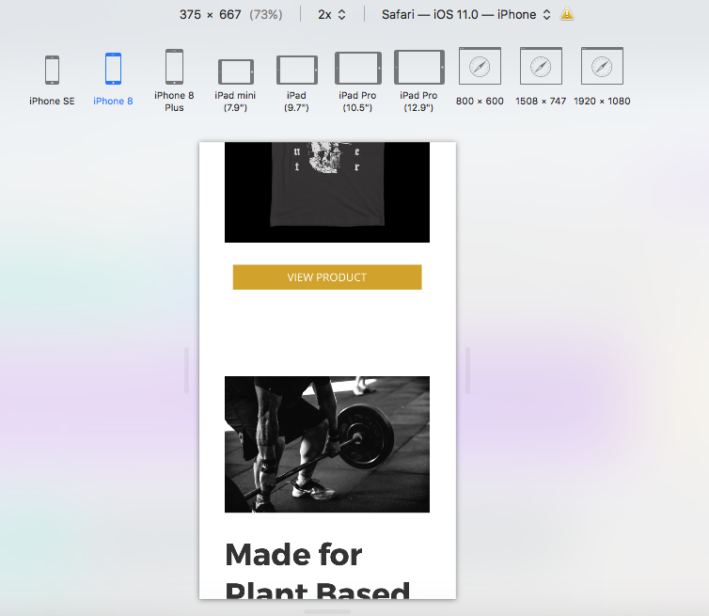
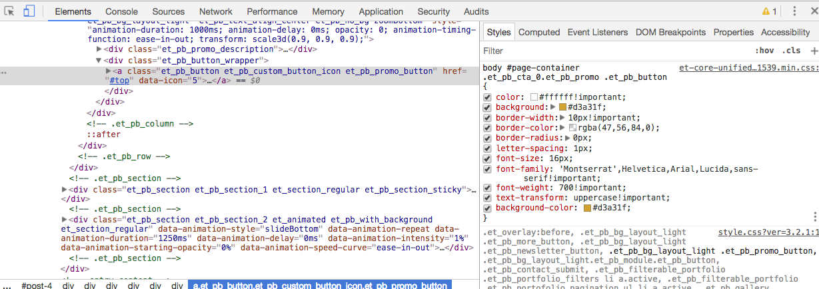
Mobile Audit
Responsive to various screen sizes,
tablets and iPhones

Slide 11
Thanks!

